Slide 1
Chapter 8 Synchronous sequential circuits
Sequential circuits
  Also called finite state machines (FSMs)
  Output depends on past behavior and present input

Slide 2
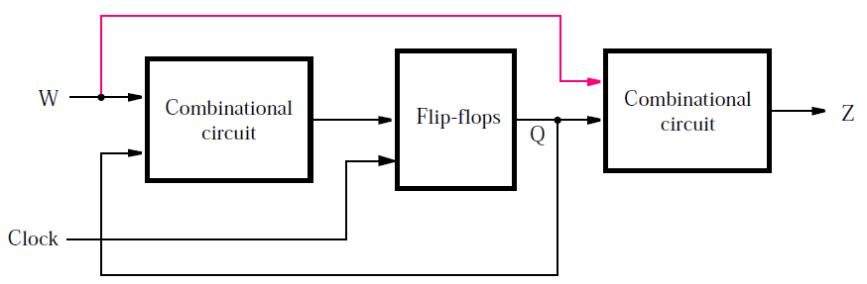
Sequential circuits
General form
  Using combinational circuits and flip-flops
  Input: W, output: Z, state: Q
  Active clock edge: edge causing state change

Slide 3
Sequential circuits
Two types
  Moore: output depends only on state (without red line)
  Mealy: output depends on both state and input (with red line)

Slide 4
Synchronous sequential circuits
Design flow
  Example: sequence detector
Moore FSM
Mealy FSM

Slide 5
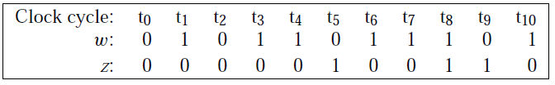
Sequence detector
Design specifications (problem statement)
  Circuit has one input (w) and one output (z)
  All changes occur at positive clock edges
  Operation: z=1 if w=1 during two immediately preceding clock cycles; z=0, otherwise

Slide 6
State diagram
Identify states to describe circuit behavior
  State A (starting state): when a reset signal is applied or w=0, circuit enters this state, z=0
  State B: w=1 for one clock cycle, z=0
  State C: w=1 for two clock cycles, z=1

Slide 7
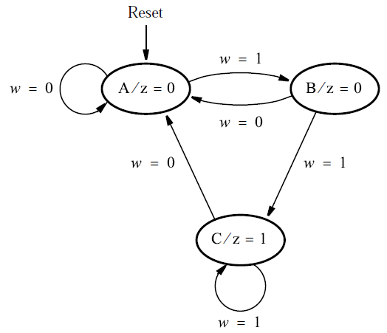
State diagram
State diagram
  Nodes: states
  Directed arcs: state transitions

Slide 8
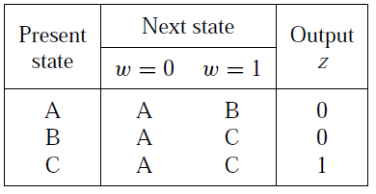
State table
Convert state diagram to state table
  First state is starting state (state A)
  Present state, next state, and state transitions
  Output is specified with respect to present state

Slide 9
State assignment
Each state is represented by a combination of state variables
Each state variable is implemented by a flip-flop
Three states (A, B, C) need two state variables (y₁, y₂)
Moore type: output only depends on state
Present-state variables: y₁, y₂
Next-state variables: Y₁, Y₂

Slide 10
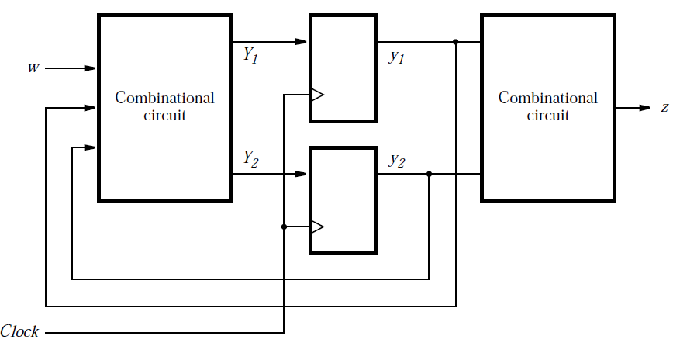
State assignment
Circuit block diagram

Slide 11
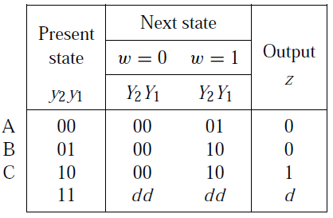
State-assigned table
Assign binary values to states
  A: 00, B: 01, C: 10
  “11” is not used

Slide 12
Choice of flip-flops
D flip-flops: transfer Y₁ and Y₂ to y₁ and y₂

Slide 13
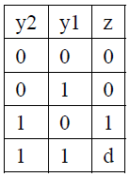


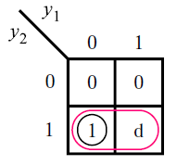
Output expression
Output expression: z
  Ignoring don’t cares:
  Using don’t cares:

Slide 14
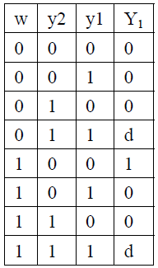


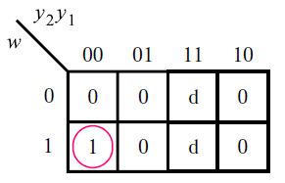
Next-state expressions
Next-state expression: Y₁
  Ignoring don’t cares:
  Using don’t cares:

Slide 15
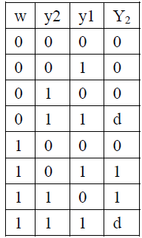


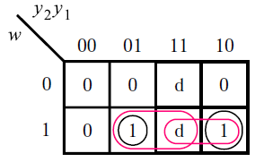
Next-state expressions
Next-state expression: Y₂
  Ignoring don’t cares:
  Using don’t cares:

Slide 16
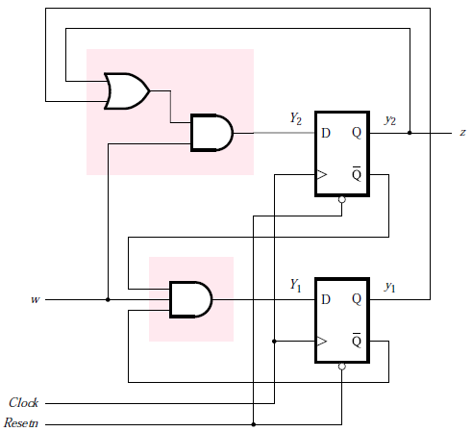
Circuit (using don’t cares)
Output
Next-state

Slide 17
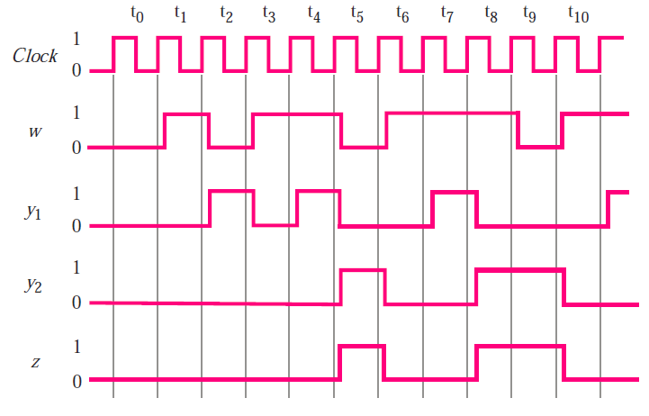
Timing diagram

Slide 18
Summary
Design steps
  Understand design specifications
  Identify states to describe circuit behavior and draw state diagram for states and transitions
  Convert state diagram to state table
  Assign state variables
  Choose flip-flops and determine output and next-state expressions
  Implement circuit

Slide 19
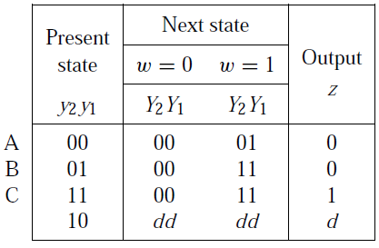
State-assignment issue
Original state assignment
  A: 00, B: 01, C: 10
  “11” is not used
Alternative state assignment
  A: 00, B: 01, C: 11
  “10” is not used

Slide 20
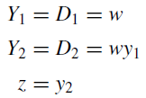
Output and next-state expressions
Expressions

Slide 21
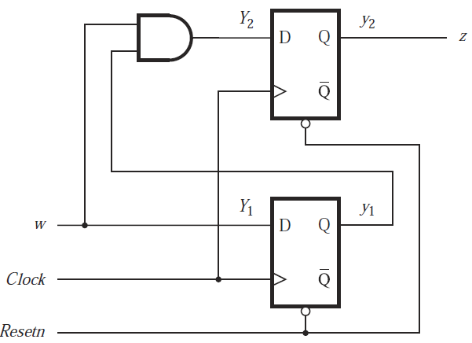
Circuit (with a lower cost)
Expressions

Slide 22





One-hot encoding
One-hot encoding
  Another approach to assign states
  Number of states equals number of state variables
  For each state, only ONE state variable is “hot”: its value is “1”. The values of all the other state variables are “0”.

Slide 23
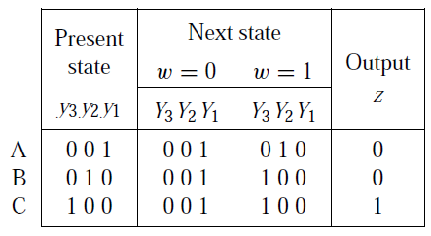
Example
State table
  Three states: A, B, C
One-hot state assignment
  Three state variables: y₃, y₂, y₁
  A: 001, B: 010, C: 100
  Other combinations of state variables are don’t cares

Slide 24
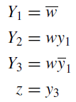
Example
Output and next-state expressions
Circuit is not simpler for this example
One-hot encoding is useful in many cases

Slide 25
VHDL code for Moore FSMs
Design input: state diagram
Example: “11” sequence detector

Slide 26
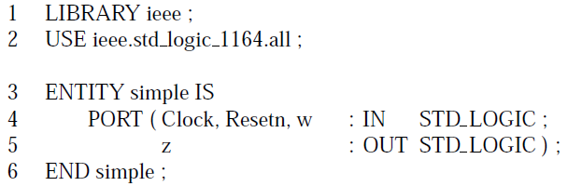
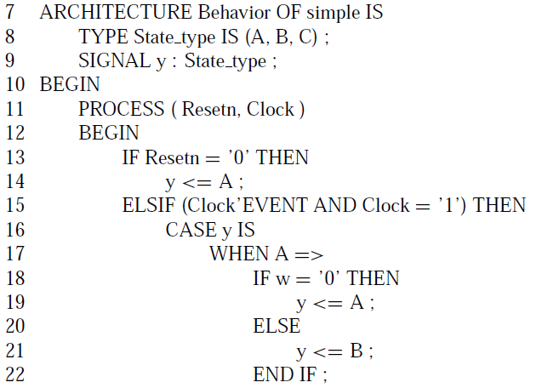
Moore type: code 1
TYPE keyword
  User-defined signal type
  Name: State_type
  Values: A, B, C
Signal y
  Type: State_type
  Describes FSM state
  Takes values (A, B, C)
Initial state A by Resetn
CASE statement
  State transitions

Slide 27
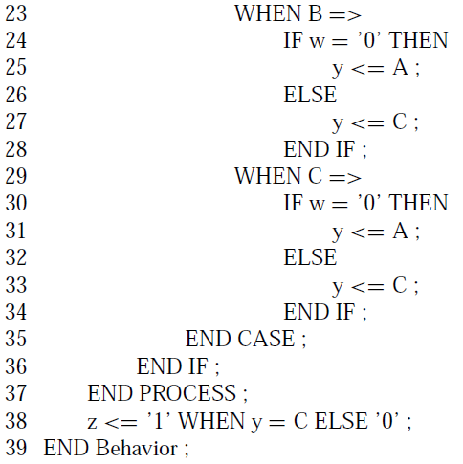
Moore type: code 1 (continued)
WHEN statement
  Output expression
Summary
  One signal (y) for state
  One PROCESS block

Slide 28
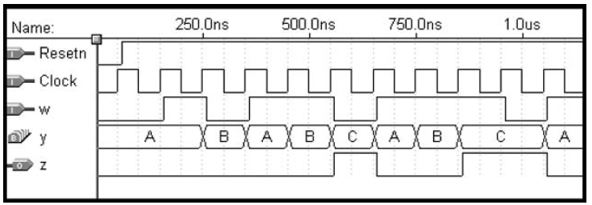
Moore type: code 1, simulation results
Signal y: state

Slide 29

Moore type: code 2
Same ENTITY
Two signals for state
  Present state: y_present
  Next state: y_next
  Same type: State_type
  Same values: A, B, C
Two PROCESS blocks

Slide 30
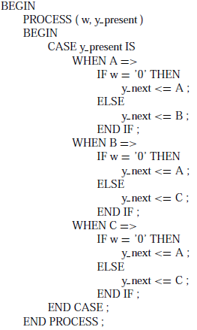
Moore type: code 2 (continued)
PROCESS 1
  Next-state expressions
  Left combinational circuit

Slide 31
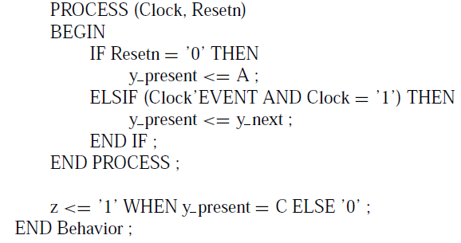
Moore type: code 2 (continued)
PROCESS 2
  State update
  Sequential circuit
WHEN statement
  Output expression
  Right combinational circuit

Slide 32
Moore type: code 3
Code 1 and 2
  Automatic state assignment
  Type of state signals (y, y_present, y_next): user-defined (State_type)
Code 3
  Manual (explicit) state assignment
  Type of state signals: standard (std_logic_vector)

Slide 33
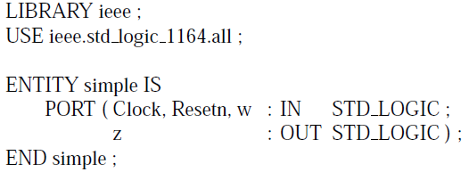
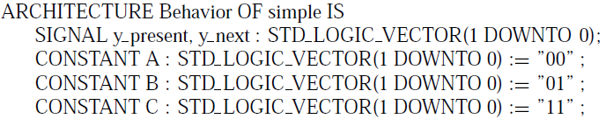
Moore type: code 3 (continued)
State assignment
  A: 00, B: 01, C: 11
State signals
  y_present, y_next: 2-bit vector
  States and values: A=“00”, B=“01”, C=“11”
  State is defined as CONSTANT
  Operator for CONSTANT value assignment: “:=”

Slide 34
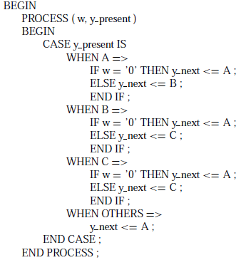
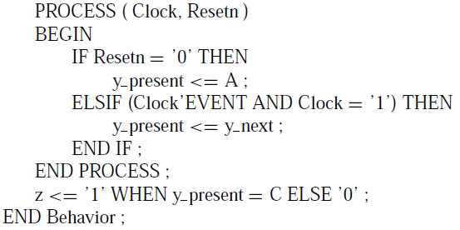
Moore type: code 3 (continued)
PROCESS 1 (right)
  WHEN OTHERS
    Covers unused values
PROCESS 2 (left)
Output (left)

Slide 35
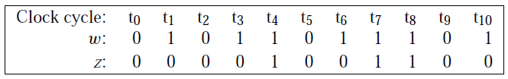
Mealy FSM
Sequence detector
  Circuit has one input (w) and one output (z)
  All changes occur at positive clock edges
  Operation: z=1 in the same clock cycle when the second occurrence of w=1 is detected; z=0, otherwise

Slide 36
Comparison: Moore FSM
Design specifications (problem statement)
  Circuit has one input (w) and one output (z)
  All changes occur on positive clock edges
  Operation: z=1 if w=1 during two immediately preceding clock cycles; z=0, otherwise

Slide 37
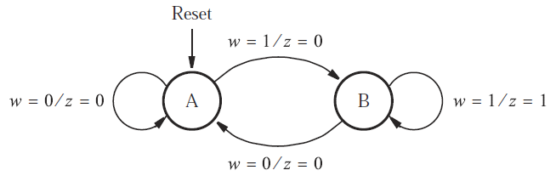
State diagram
States
  State A (starting state): when a reset signal is applied or w=0, circuit enters this state
  State B: w=1 for one clock cycle

Slide 38
Comparison: Moore FSM
State diagram
  Nodes: states
  Directed arcs: state transitions

Slide 39
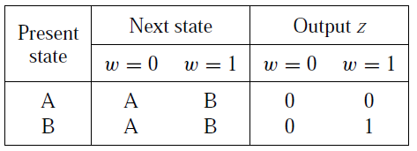
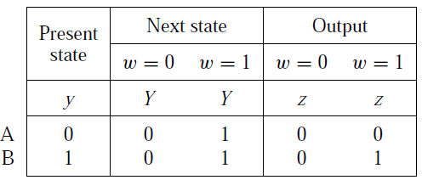
State table and state-assigned table
Two states: A and B
One state variable: y
  A: 0, B: 1

Slide 40
Comparison: Moore FSM
Convert state diagram to state table
  First state is starting state (state A)
  Present state, next state, and state transitions
  Output is specified with respect to present state

Slide 41

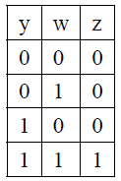
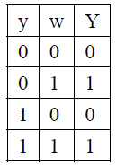
Output and next-state expressions
Expressions
Truth table: output and next-state

Slide 42
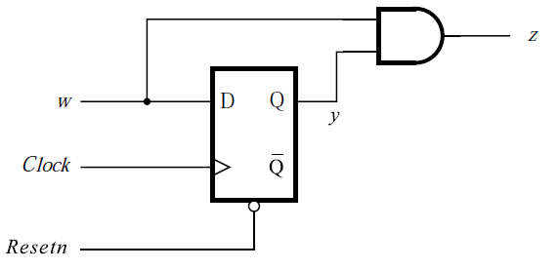
Circuit
Expressions

Slide 43
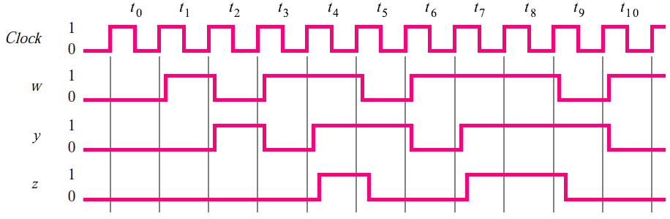
Timing diagram

Slide 44
VHDL code for Mealy FSMs
Design input: state diagram
Example: “11” sequence detector

Slide 45
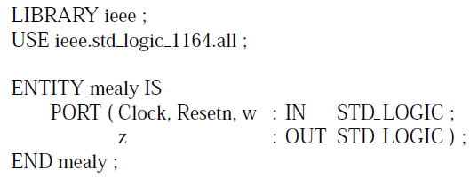

Mealy type code
Similar to Moore type code 1
Two states: A, B
User-defined state signal type: State_type

Slide 46
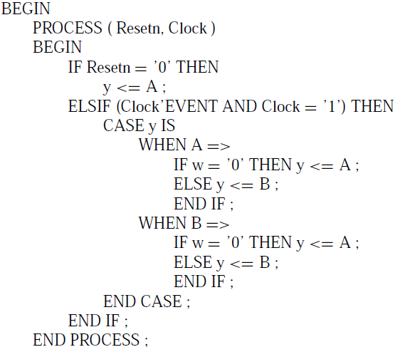
Mealy type code (continued)
PROCESS 1
  State transitions

Slide 47
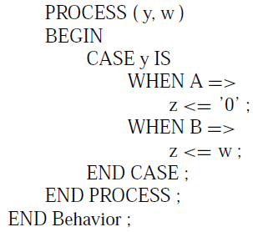
Mealy type code (continued)
PROCESS 2
  Output depends on y and w

